Slide 1
Software Development on Java
Dzmitry Marchankau 2023

Slide 2
Data storages
Relational DBs
NoSQL storages
Data persistence with Java

Slide 3
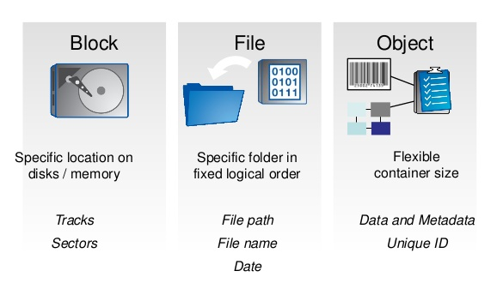
Data storage types

Slide 4
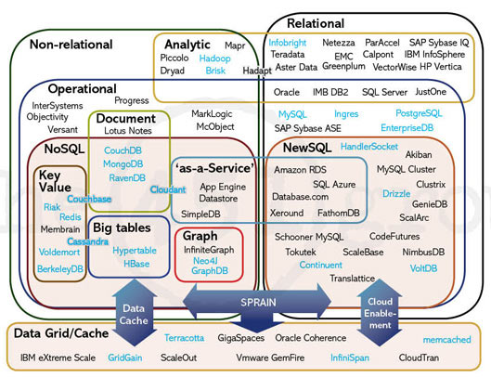
Databases types

Slide 5
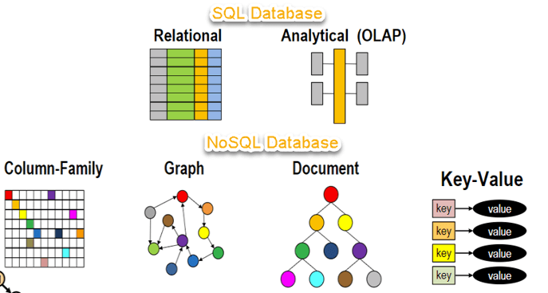
Databases types

Slide 6
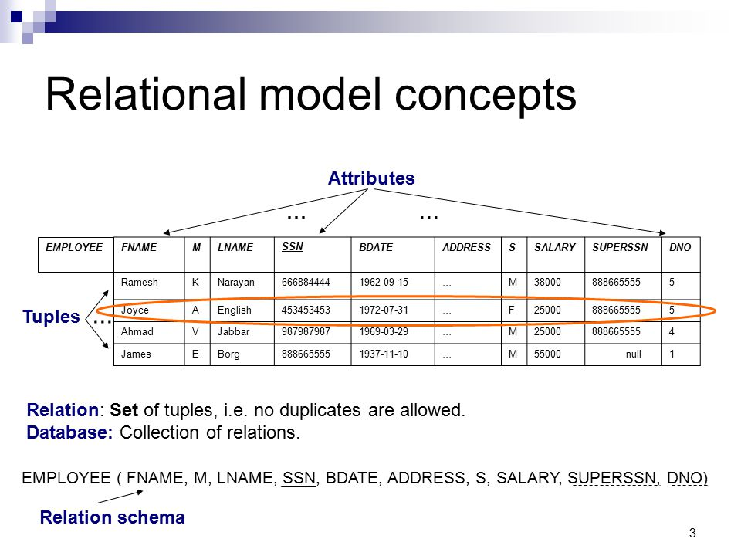
Relational DB concepts

Slide 7
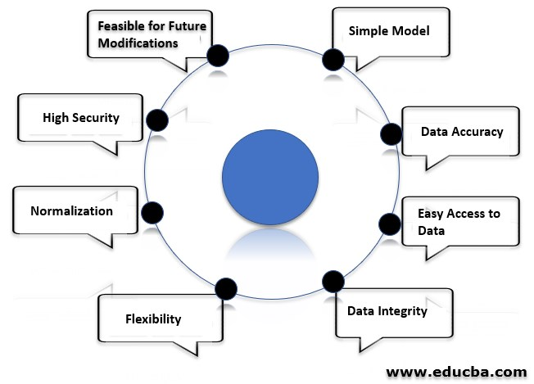
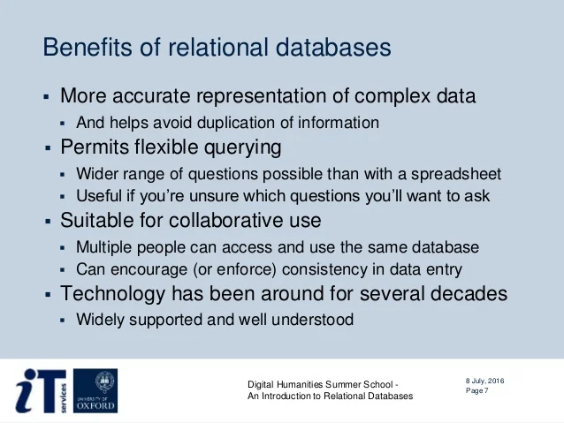
Relational DB benefits

Slide 8

SQL language

Slide 9
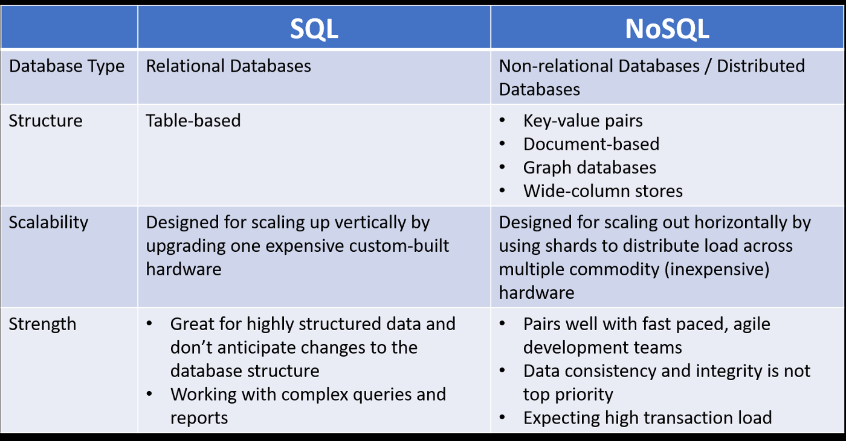
Relational DBs vs NoSQL

Slide 10
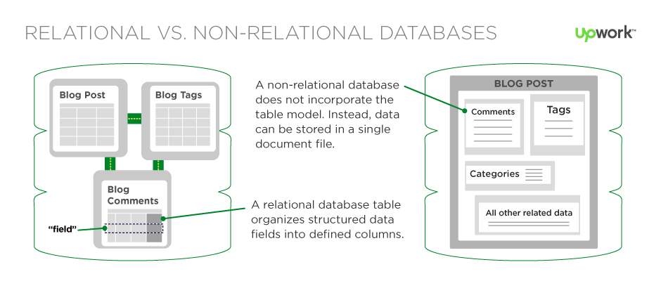
Relational vs NoSQL – common view

Slide 11
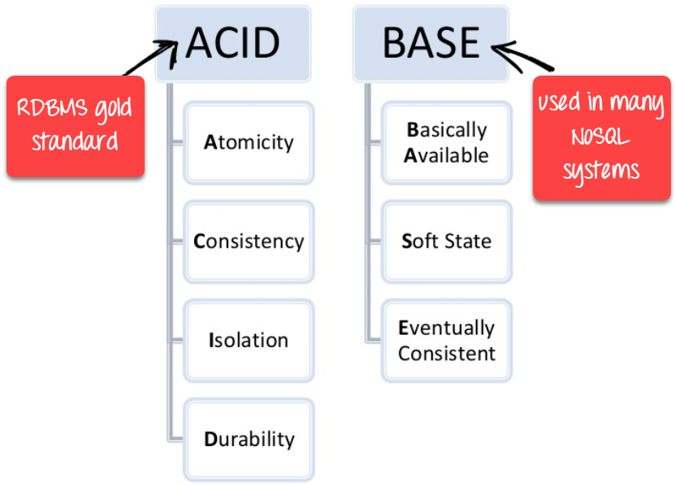
Relational vs NoSQL – ACID vs BASE

Slide 12
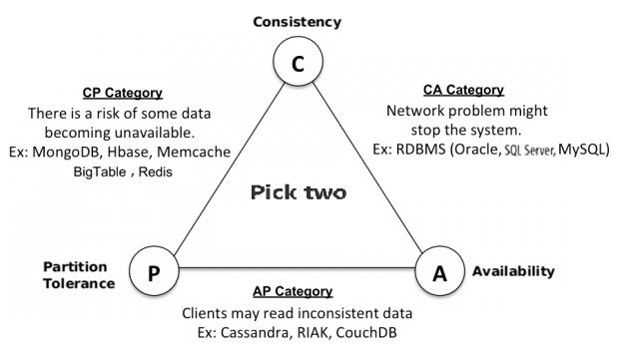
CAP theorem

Slide 13
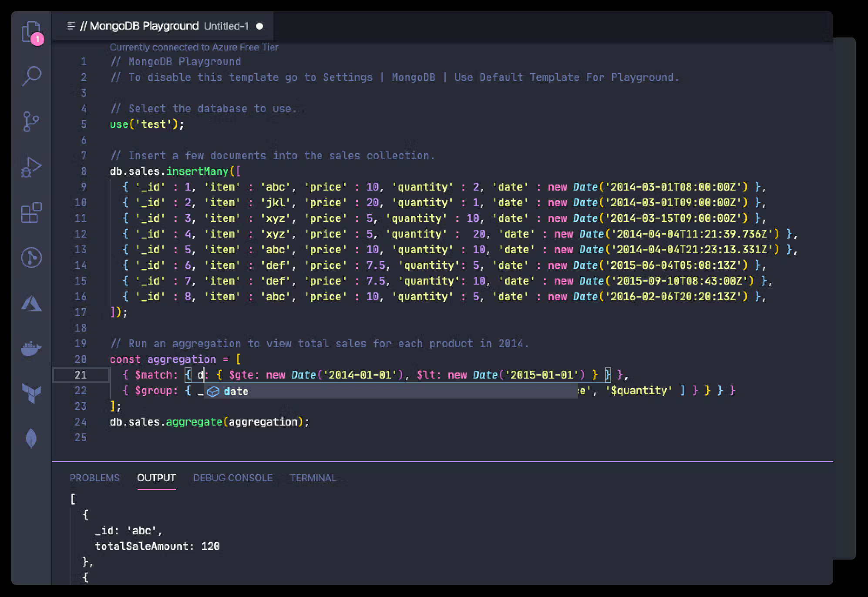
MongoDB

Slide 14
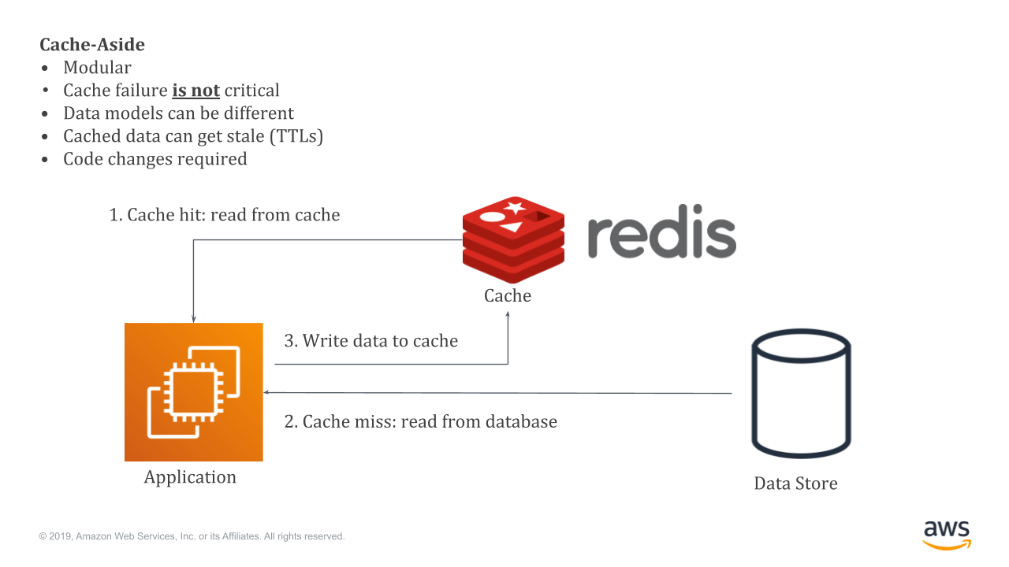
Redis usage

Slide 15
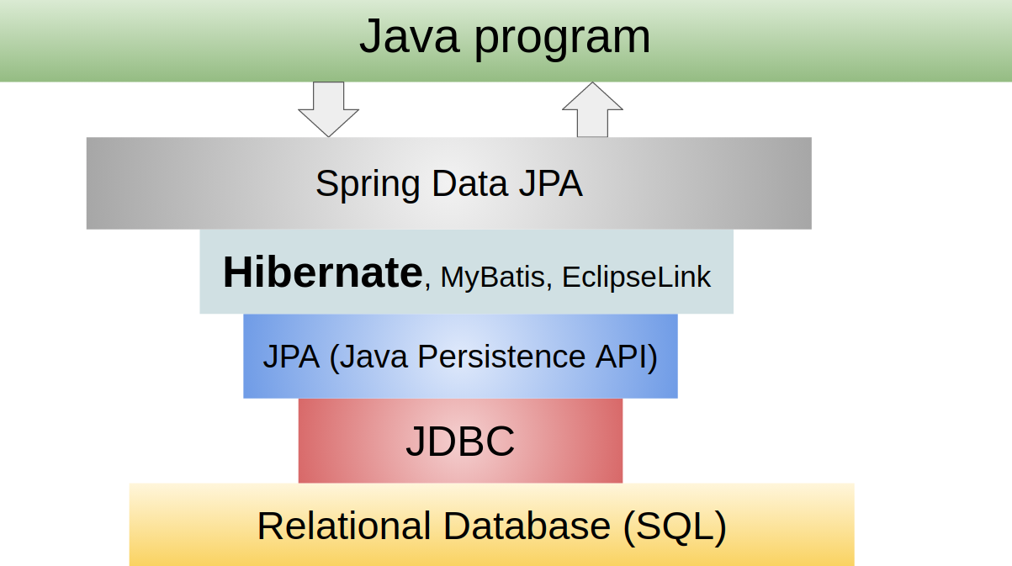
Java DB interaction

Slide 16
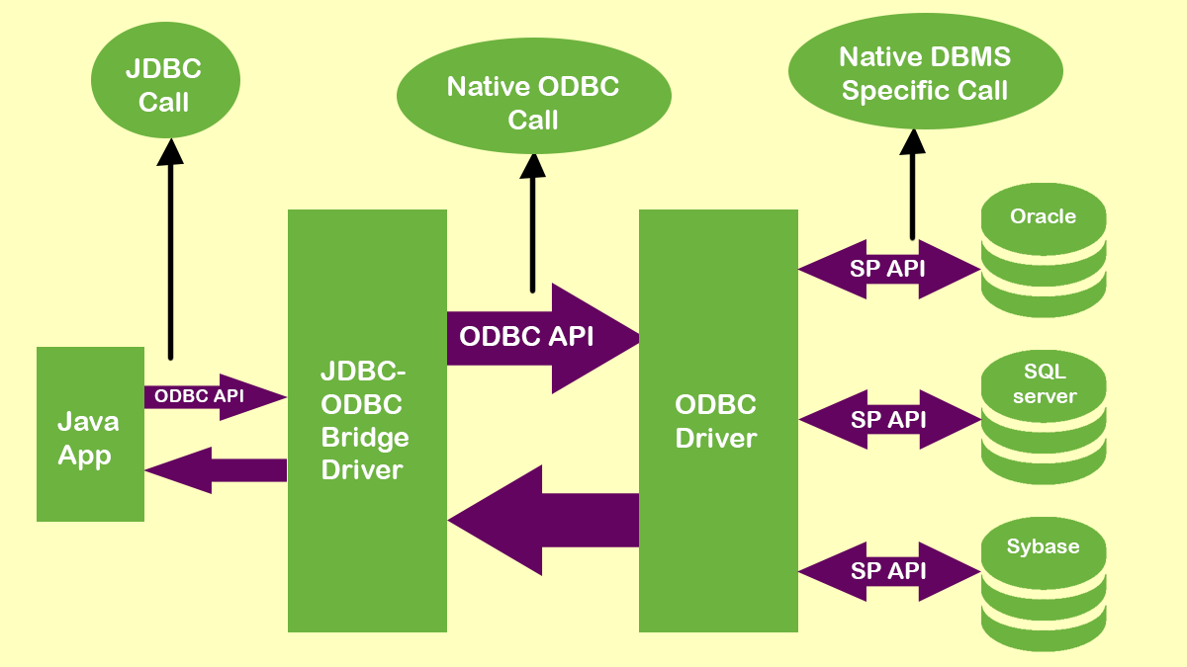
ODBC/JDBC
Notes:
Open Database Connectivity (ODBC), Java Database Connectivity (JDBC)

Slide 17
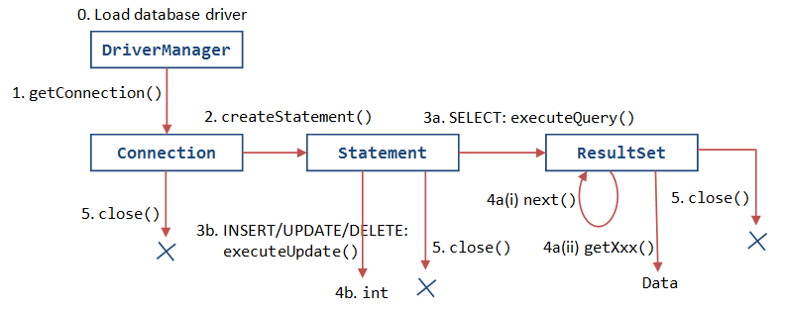
JDBC usage

Slide 18
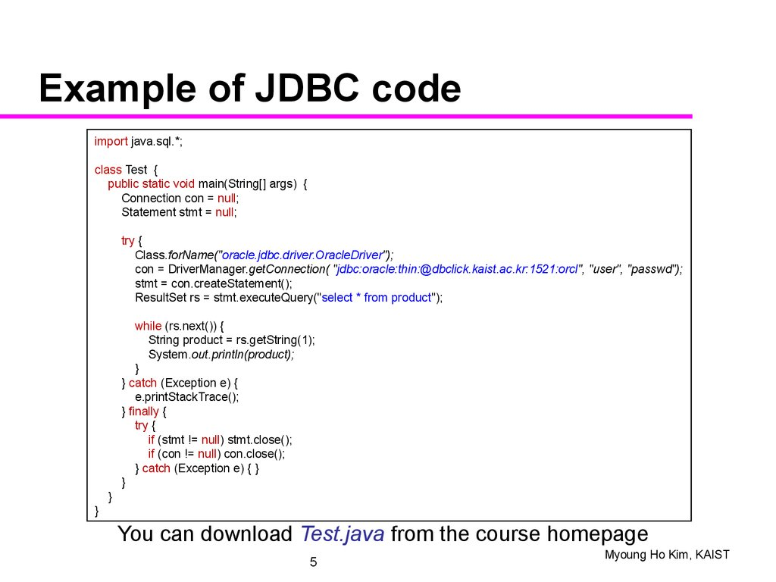
JDBC usage

Slide 19
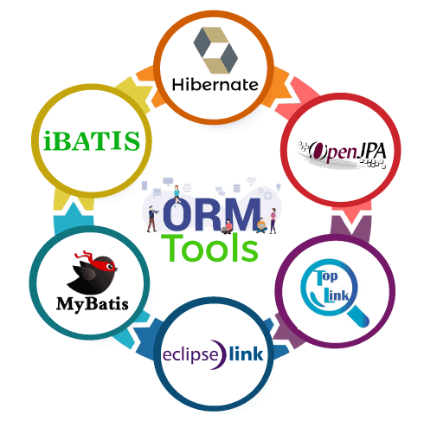
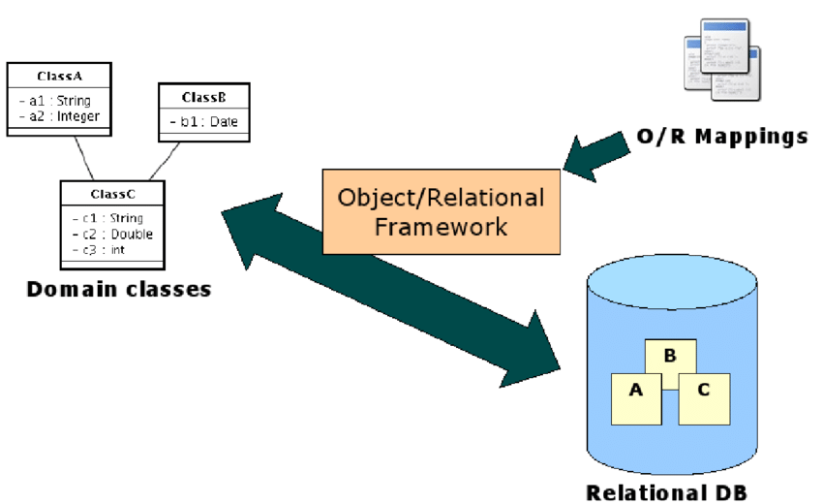
ORM frameworks

Slide 20
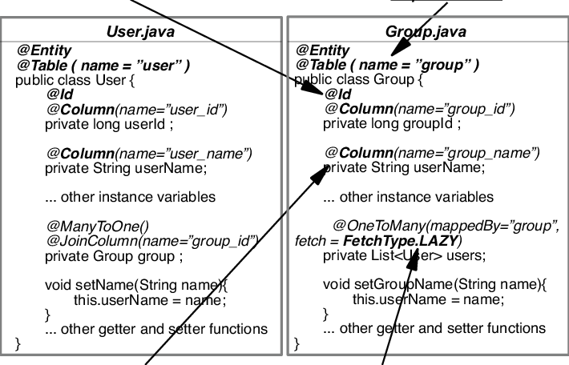
Hibernate entity example

Slide 21
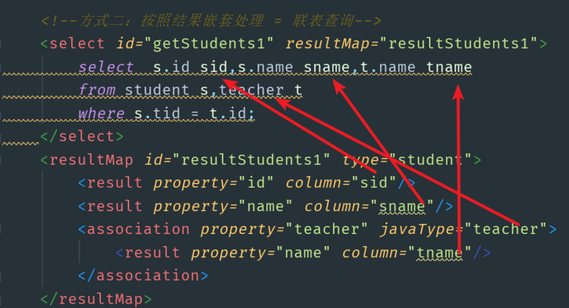
MyBatis mapper example

Slide 22
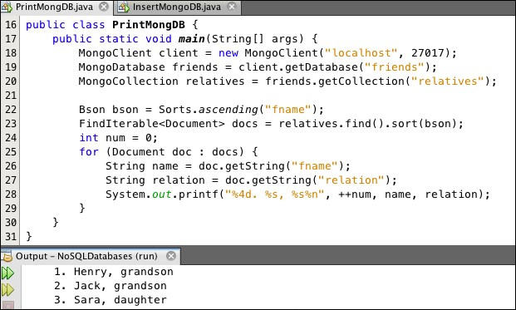
MongoDB usage example

Slide 23
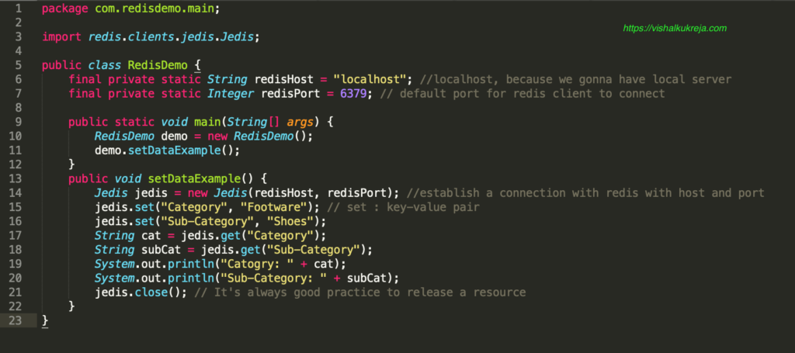
Redis usage example

Slide 24
Questions ?

